Slide 1
Storytelling Through Gameplay

Slide 2
Night in the Woods as a virtual exform
Nicolas Bourriaud describes the exform as, “a point of contact, a ‘socket’ or ‘plug’, in the process of exclusion and inclusion - a sign that switches between centre and periphery, floating between dissidence and power.”
Possum Springs, exists in the realm of the exformal, being a dying, run-down town that only people with personal connections to the town have any reason to live in or even visit
Although Possum Springs is fictional, it represents various towns in this type of decay. The game allows the player to experience this type of exformal town, through Mae’s experience, and it does this through its gameplay.

Slide 3
Games are Interactive
Video games can effectively tell stories in ways that cannot be done in other media.

Slide 4
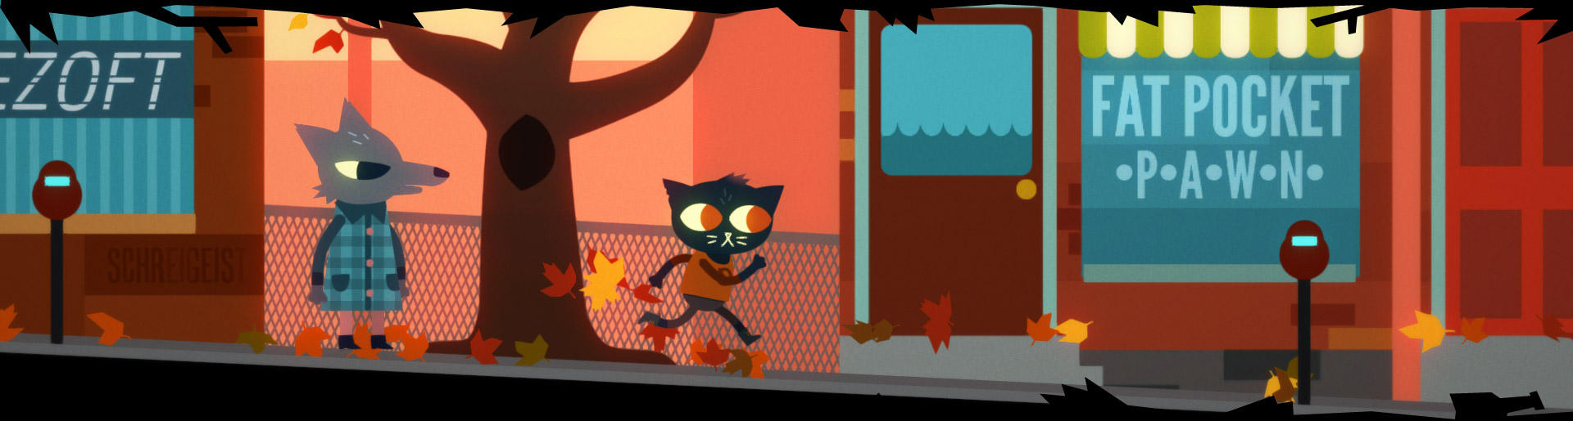
Game Architecture
The architecture of games has both a functional gameplay purpose as well as being part of the game’s setting and showing the history of the game’s world and story.
In Night in the Woods, the game’s architecture functions as platforms for Mae to jump between, as locations to enter and interact with the people in town, or just as part of the game’s setting and world with no gameplay function.

Slide 5
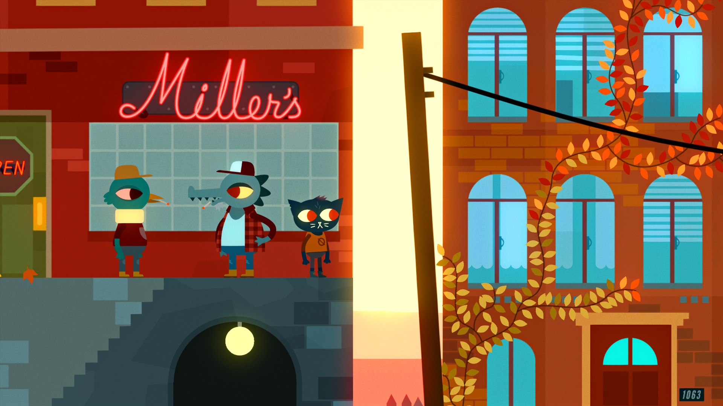
“a slice of Mae’s life”¹
By controlling Mae’s actions, the player can relate to her and understand her thoughts and emotions in a deeper way than would be possible by simply observing a character in other media.
Most of the gameplay consists of just wandering around, getting to know the characters.

Slide 6
The Story Reflected in Gameplay
One way Night in the Woods tells its story is through repetition.
Repetition is not only used in the narrative, but the gameplay as well.
Another detail is that at the beginning of the game, the player moves from right to left. This is significant because most 2D platformers have the player primarily moving from left to right.
Aleksandra Mochocka and Radosław Piotr Walczak argue that since left to right movement usually represents moving forward, moving right to left represents Mae coming back to her past.²

Slide 7
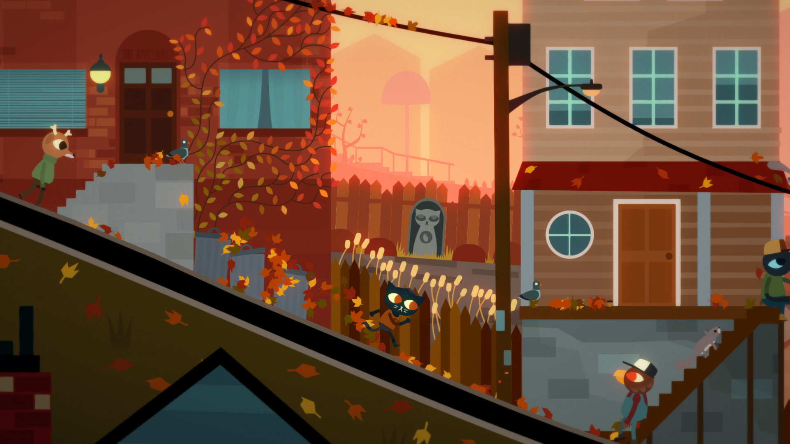
Walking as Central Gameplay
Night in the Woods emphasizes exploration, wandering around, and piecing together a story, which Melanie Kreitler argues, “serves as a metaphor for Mae’s (re)construction of her life.”³
Night in the Woods uses walking around as its central gameplay rather than as a utility to get from place to place.
Walking around is how Mae lives her life and has fun, and is also how the player plays the game and has fun.

Slide 8
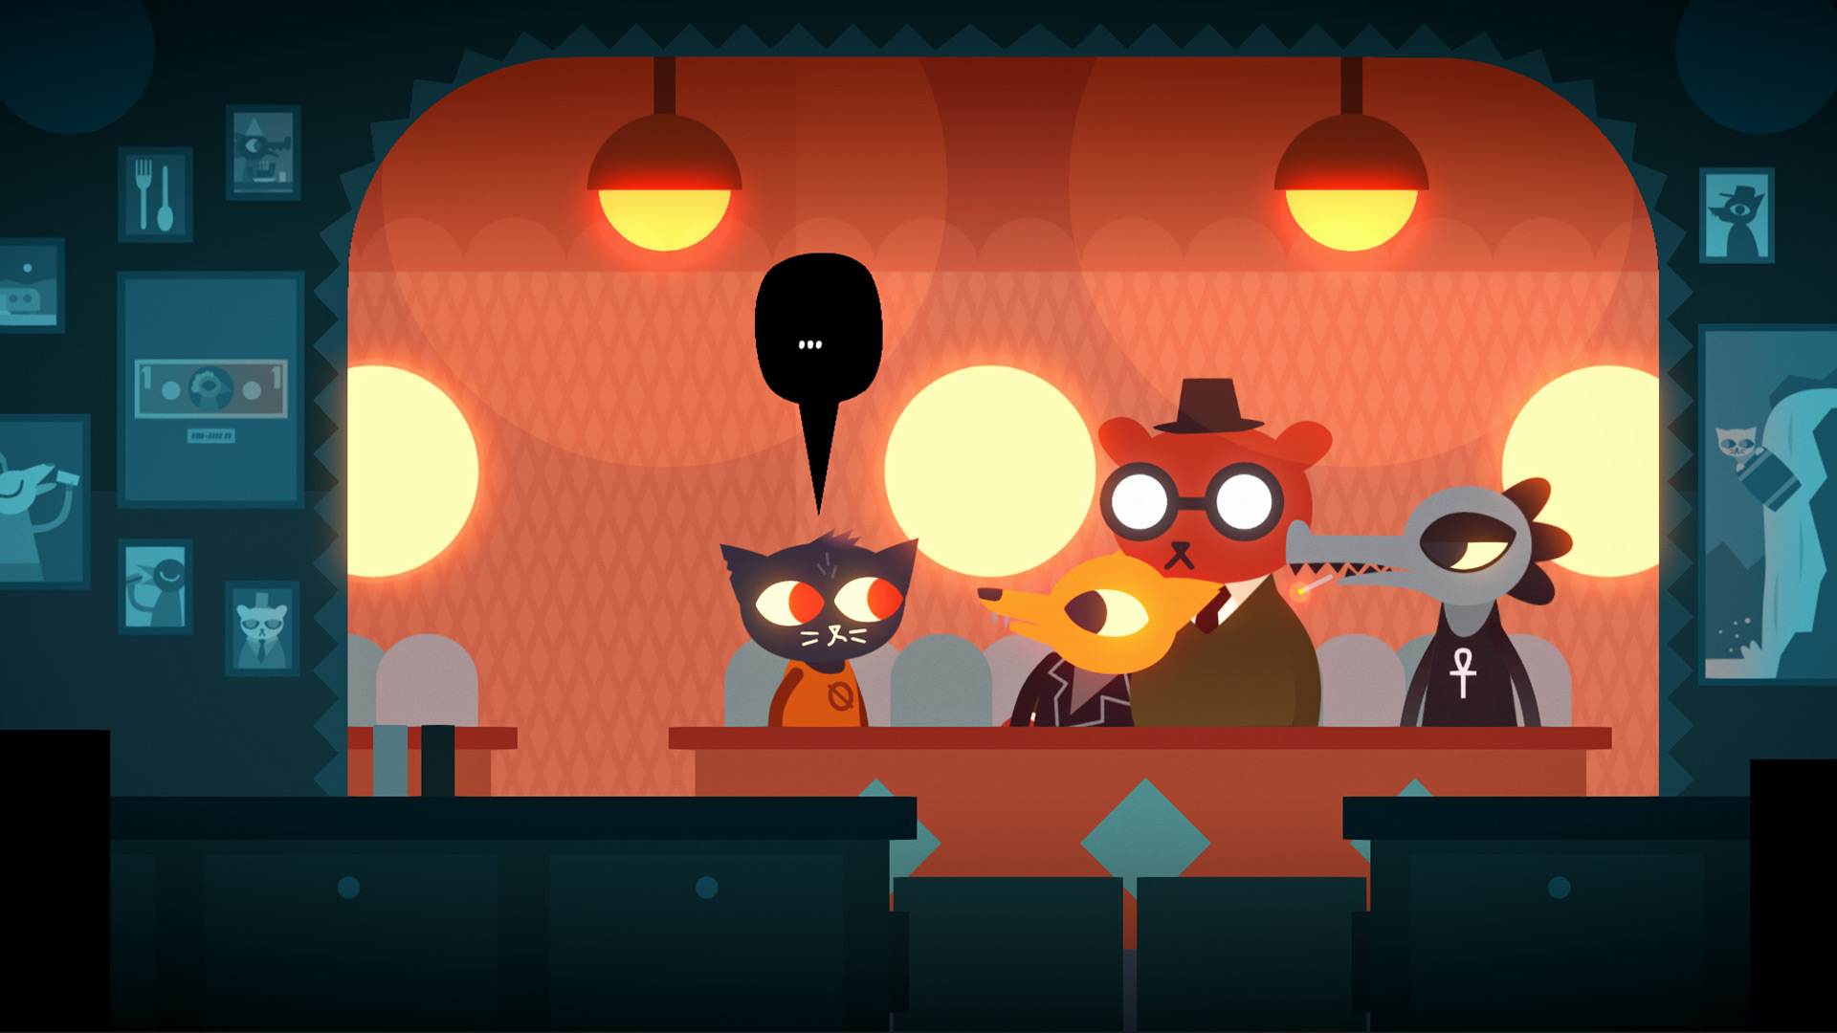
Purposely Aimless Gameplay
Miguel Penabella argues that the aimlessness of the gameplay of Night in the Woods represents Mae’s aimlessness in her life.⁴
He also says that the game “ultimately values empathy and effort,”⁵ which I think is reflected in the fact that the main gameplay revolves around getting to know and doing stuff with the other characters. Relationship and friendship is a central theme in not only the game’s story, but also its gameplay.

Slide 9
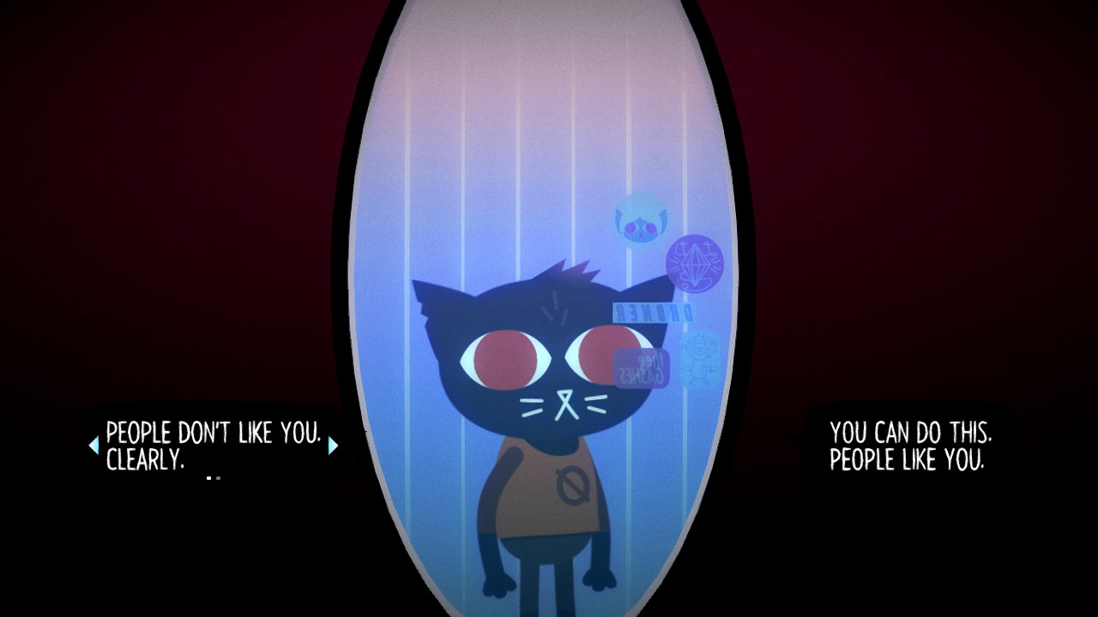
Choices and Consequences
Kevin Veale talks about how choices in video games often are meaningful and have consequences in the game.⁶ Because of this, players of video games tend to feel responsible for their choices, even for choices that are insignificant to the story or in general.
The player gets to know Mae through the choices they make, and can come to feel responsible for her choices, even if all the options are bad.

Slide 10
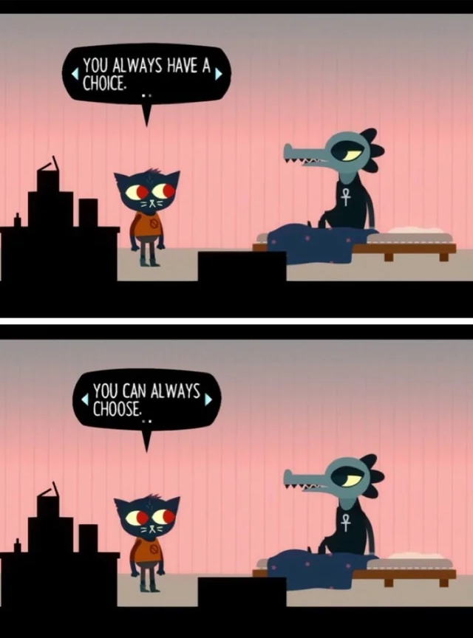
Mae Isn’t the Player
Unlike some other games, Night in the Woods has Mae fully be her own character, and not just an extension of the player.
The choices that the player can make are limited by Mae’s personality and what she would do.
Melanie Kreitler observes that limiting the player’s choices like this “puts players in the same mental space as Mae.”⁷

Slide 11
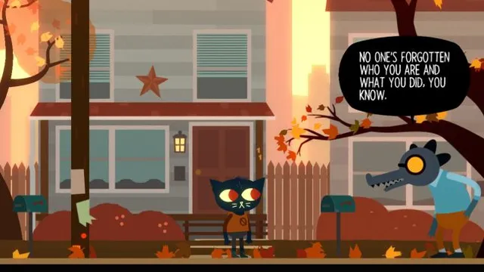
Limited Exploration
The player is restricted to a specific area in Night in the Woods. They can’t just go anywhere.
This is not only needed for the game to work, but Aleksandra Mochocka and Radosław Piotr Walczak argue that it also symbolizes how Mae feels trapped, just like many of the other characters in Possum Springs.⁸
The player can get to know Mae and relate to her by experiencing what she’s experiencing and feeling what she’s feeling through the choices they make, even though, in reality, they don’t have much actual control over Mae’s actions.

Slide 12
Conclusion
Night in the Woods takes advantage of what video games can uniquely do as a medium to tell its story in an effective way. The player can feel a deep connection to Mae through the actions they take while playing as her, and even by the actions that they can’t take. The player’s interaction with the environment tells the story of Mae, her friends, and Possum Springs in a way that can only be done through an interactive medium like video games.

